Slide 1
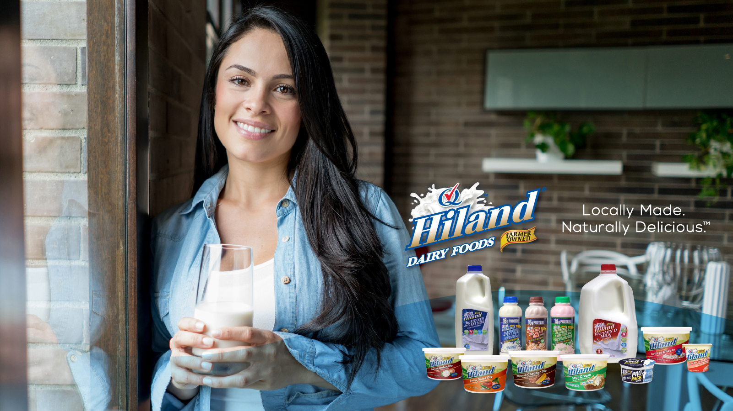
Alternative Title Slide
Subhead goes here
Date

Slide 2
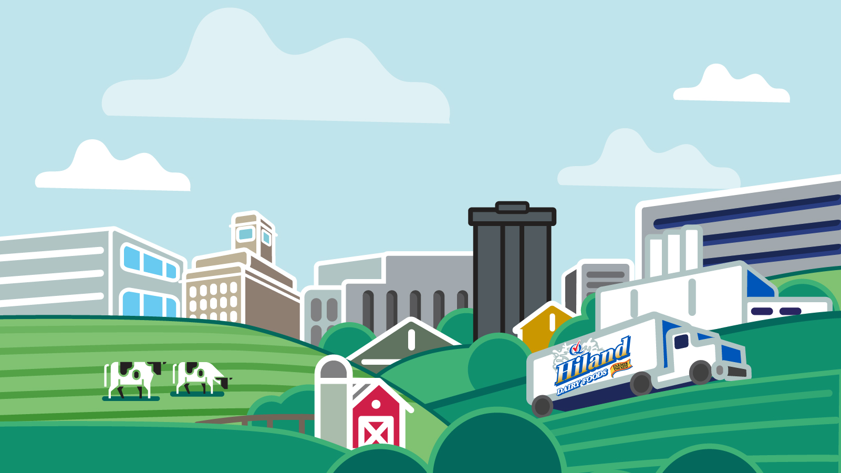
Dairy Is Essential for Communities & Retailers
Dairy is a high-frequency purchase that drives repeat visits and customer loyalty.
Consumers actively seek fresh, high-quality, and innovative dairy products.
Hiland Dairy delivers locally made, naturally delicious options that align with today’s trends.

Slide 3
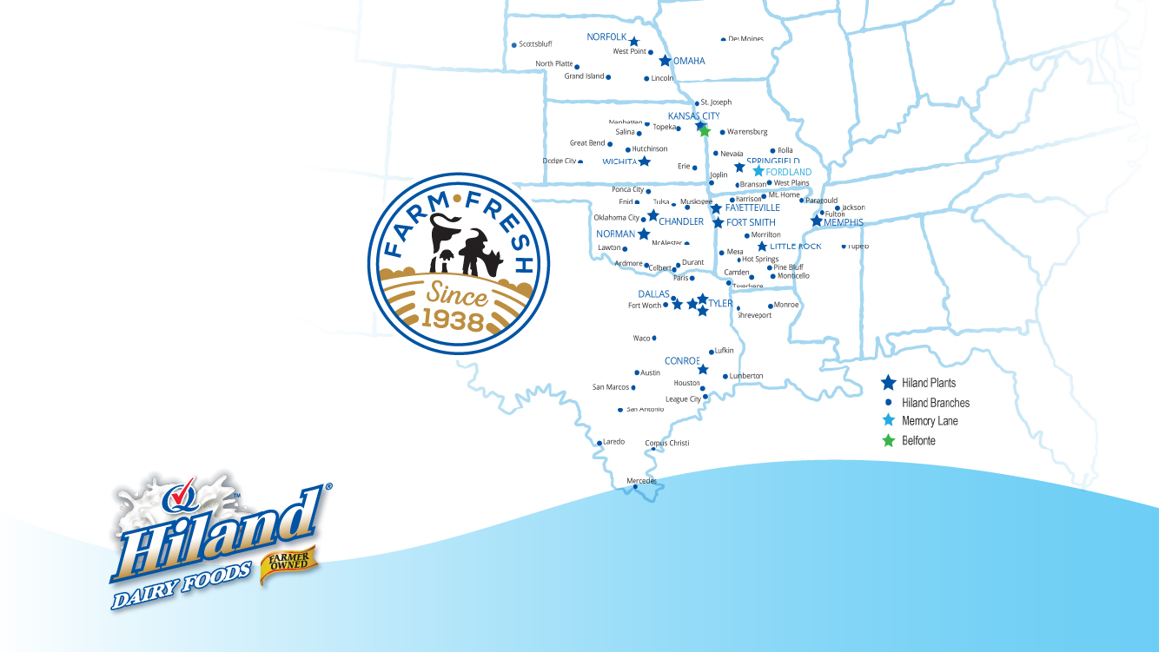
Being better than we have to be, since 1938.
Hiland Dairy ensures trusted quality and innovation.
Operating across multiple states with 18 processing plants and 63 distribution centers.
4,000+ employees dedicated to freshness, sustainability, and customer satisfaction.

Slide 4
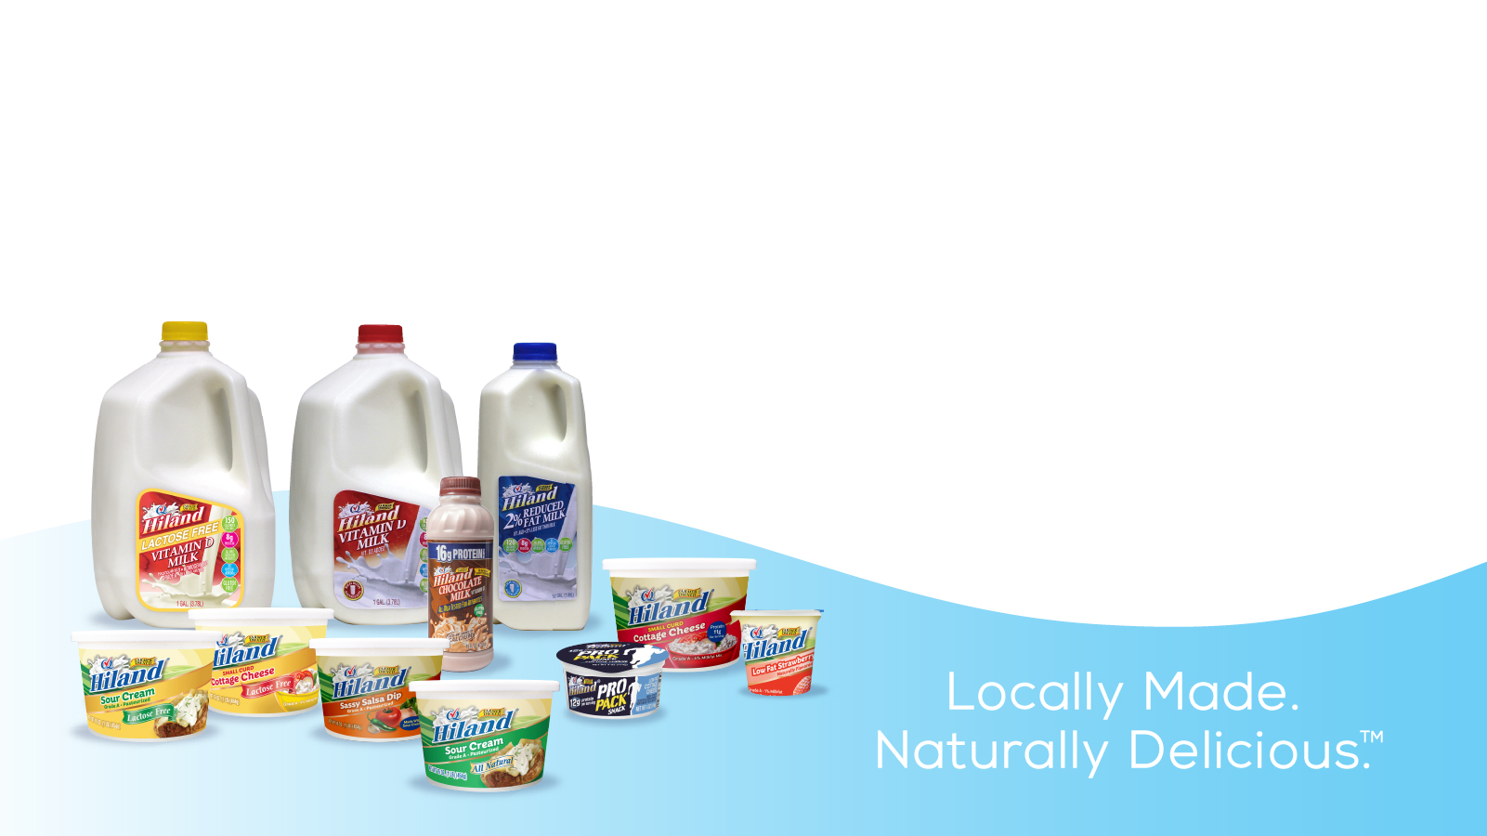
Expanding Choices to Meet Consumer Demand
ProPack Snack – High-protein cottage cheese in convenient, on-the-go packaging.
New Yogurt Packaging – Designed for freshness and sustainability.
Lactose-Free Cottage Cheese & Sour Cream – Meeting dietary needs with great taste.
Fresh Milk – Locally sourced, high-quality milk with a strong distribution network.
Eco-Friendly Packaging – In-Mold Label (IML) technology extends shelf life and reduces waste.

Slide 5
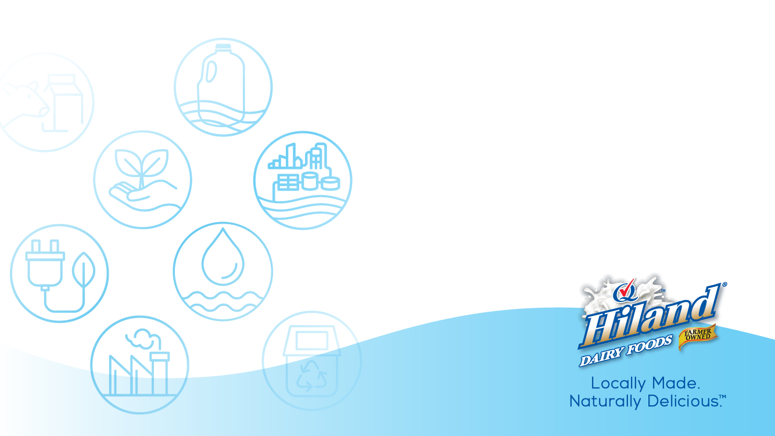
Sustainable Practices That Support a Stronger Future
Energy-Efficient Operations – LED lighting, recycling programs, and water conservation.
Eco-Friendly Packaging – Reducing waste through IML technology.
Local Dairy Sourcing – Minimizes the impact of transportation while supporting local farmers.
Industry Leadership – Committed to the U.S. Dairy Stewardship Commitment.

Slide 6
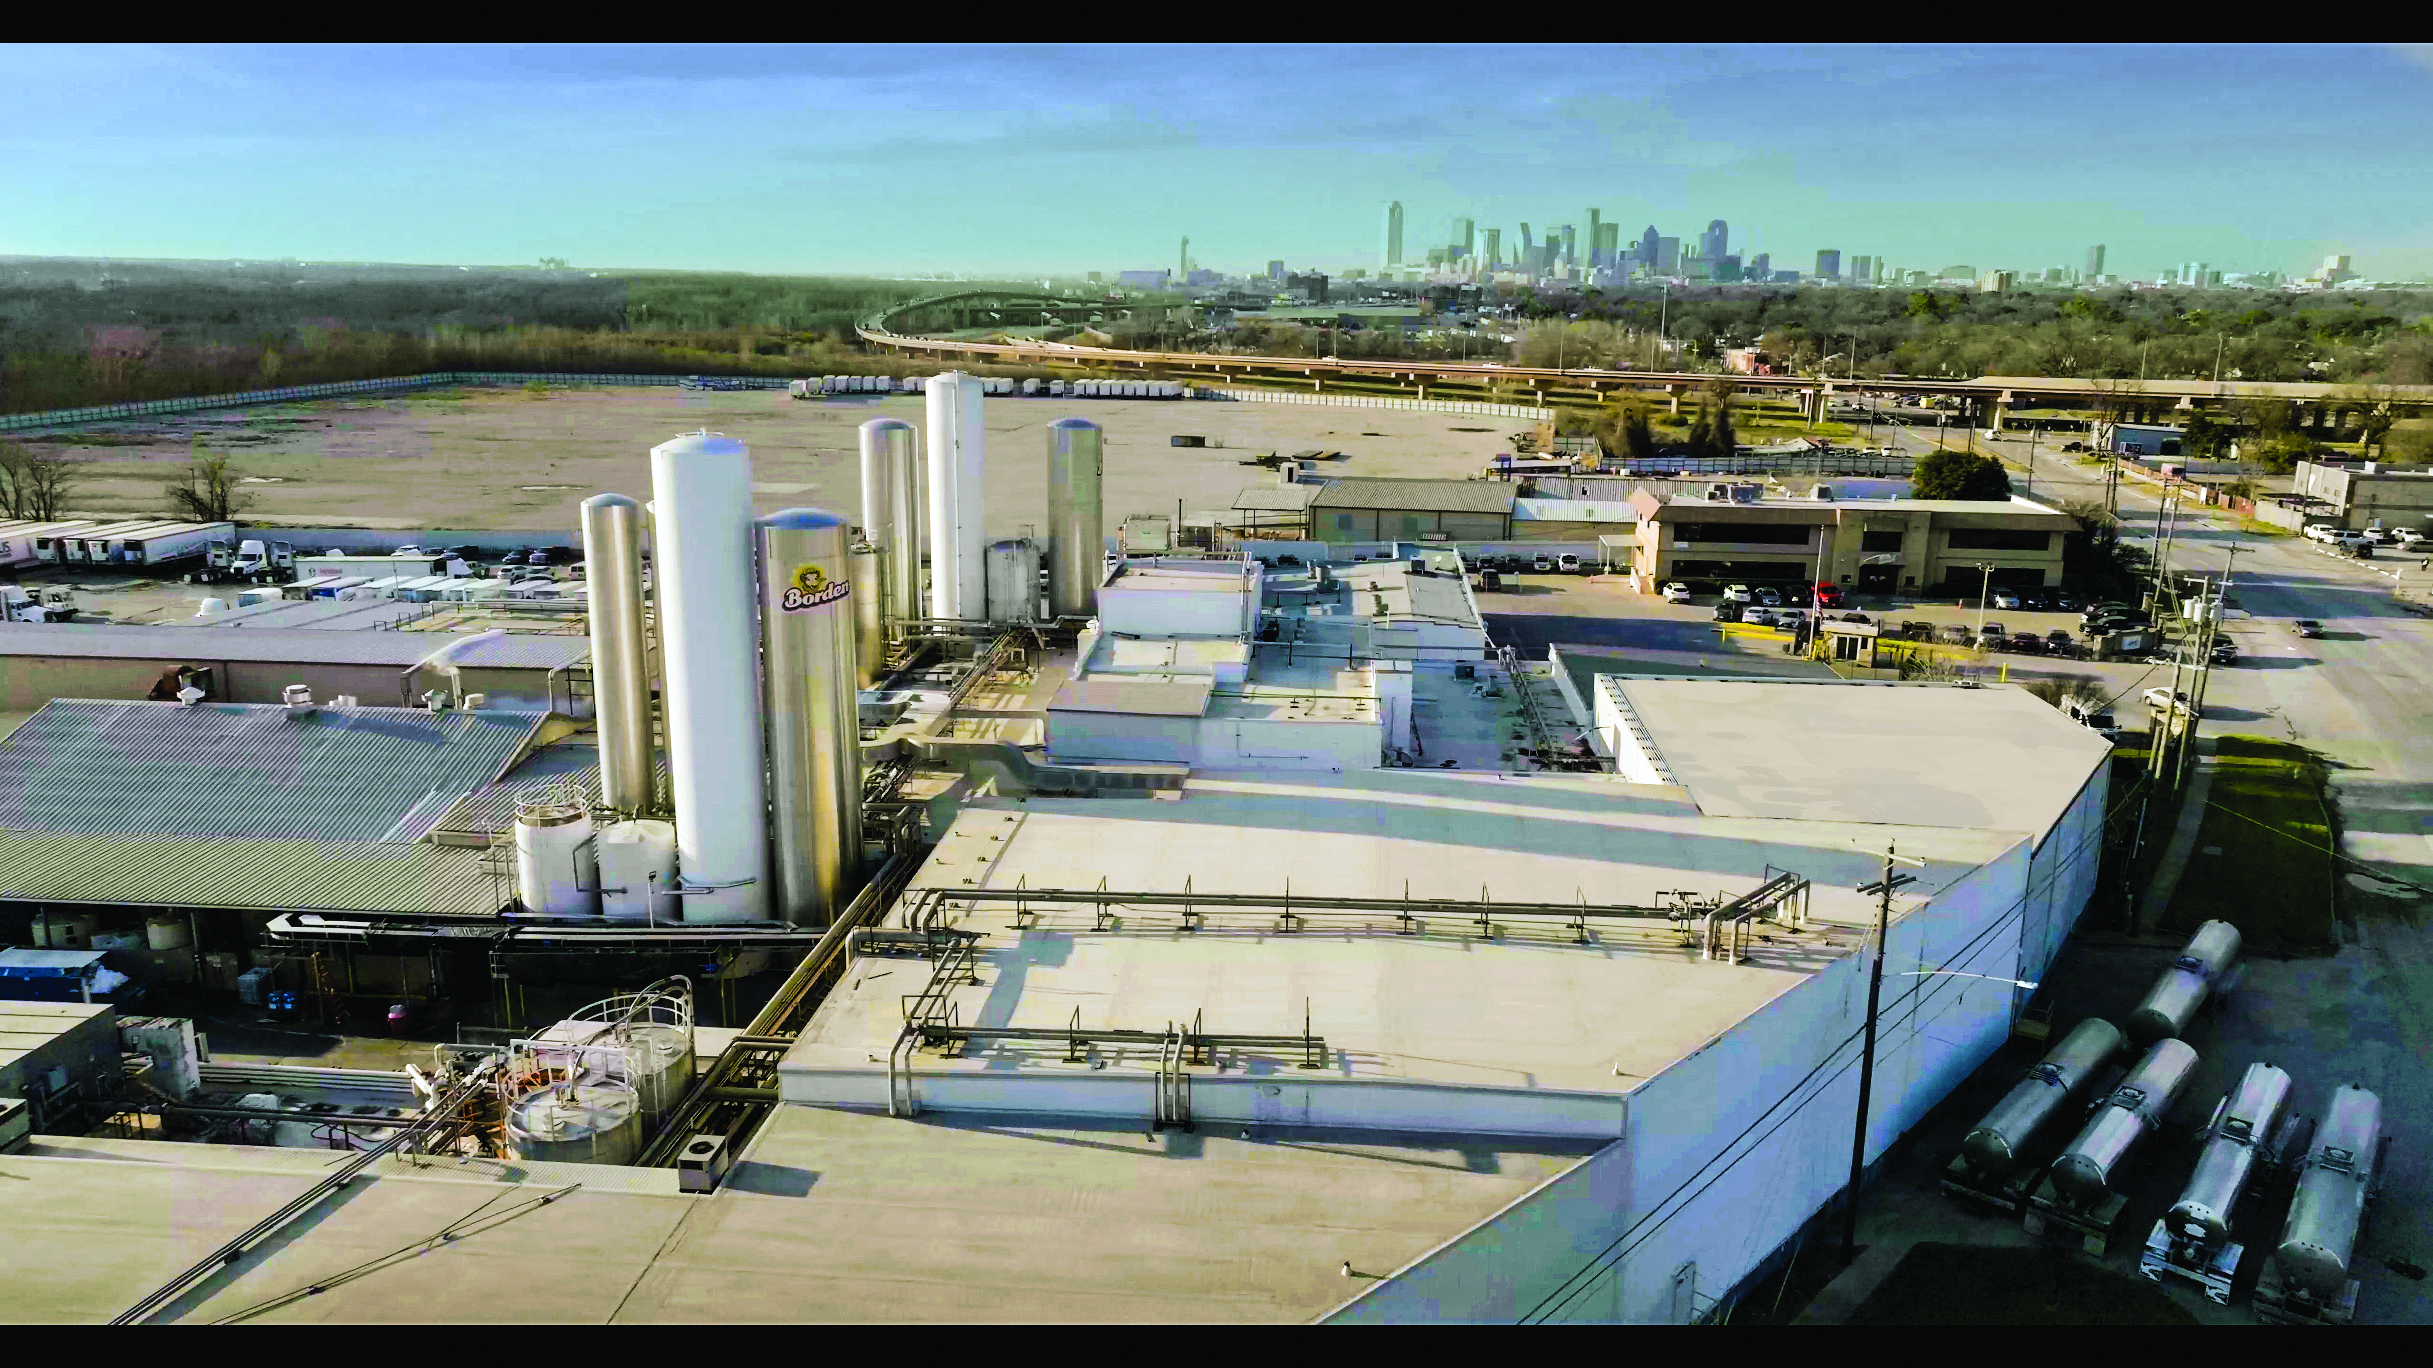
Strengthening Our Presence with State-of-the-Art Facilities
Dallas Plant Expansion – Investment in new production equipment, packaging solutions, and logistics.
Tyler Facility Expansion – 90,000-square-foot facility upgrade including new processing and lab space.
Conroe Plant Enhancements – New 50,000-gallon silo, receiving bay remodel, and improved cooling systems.
Greater Efficiency & Reliability – Enhancing product quality, freshness, and supply chain speed.

Slide 7
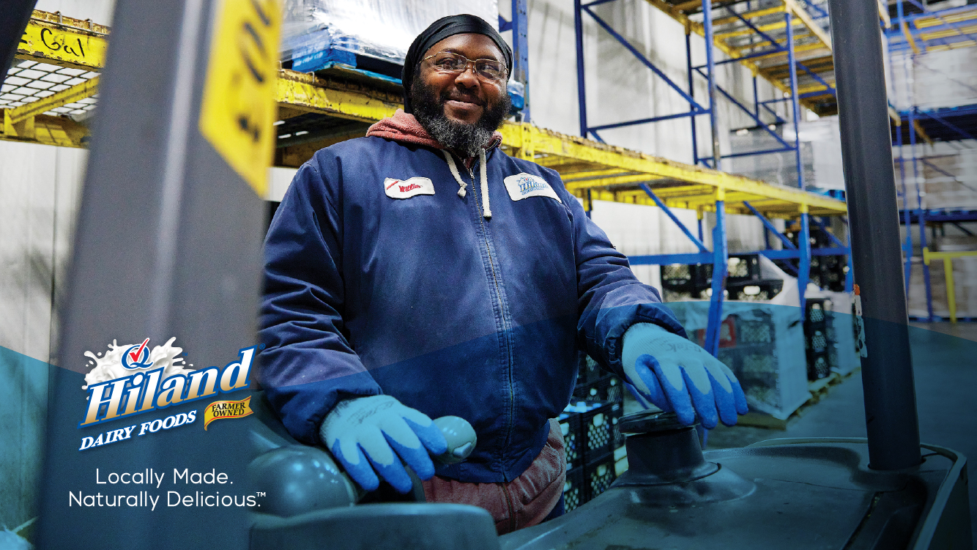
People Are the Heart of Our Success
4,000+ employees across multiple locations, reflecting local diversity.
Hiland Dairy invests in employee training, safety, and well-being.
Supporting Local Communities – School nutrition programs, food donations, and educational initiatives.
Partnerships That Make a Difference – Collaborating with schools, healthcare providers, and retailers.

Slide 8
Dairy Market Trends for [Local Market Name]
Dairy product sales trends for [specific city or state].
Growth in consumer demand for lactose-free, high-protein, and organic dairy.
Competitive landscape and opportunities for business growth.
Hiland’s role in meeting local demand with fresh, high-quality dairy.
FPO Chart

Slide 9
Delivering Dairy Success for [Customer Name]
Quote from a satisfied customer + relevant business results.
Case study showcasing how Hiland Dairy supports customer success.
Results from implementing Hiland’s dairy solutions (sales growth, efficiency, etc.).
Customer testimonials or partnership highlights.
Quote from a satisfied customer + relevant business results.

Slide 10
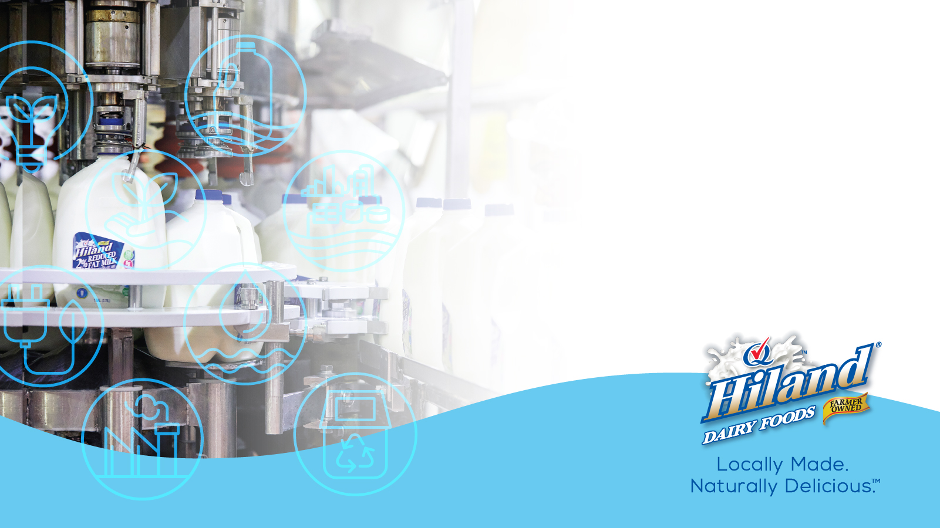
Why Partner with Hiland Dairy?
Fresh, High-Quality Dairy Products – In addition to complying with strict USDA and FDA regulations, Hiland is proud to be a member of Quality Chekd, ensuring our products meet even higher standards of quality and excellence.
Innovation – Meeting modern consumer demands with new product lines.

Slide 11

Why Partner with Hiland Dairy?
Sustainability Leadership – Supporting ESG goals and responsible sourcing.
Reliable Distribution & Support – Ensuring freshness and availability.
Local & Regional Strength – Strong partnerships across multiple industries.

Slide 12
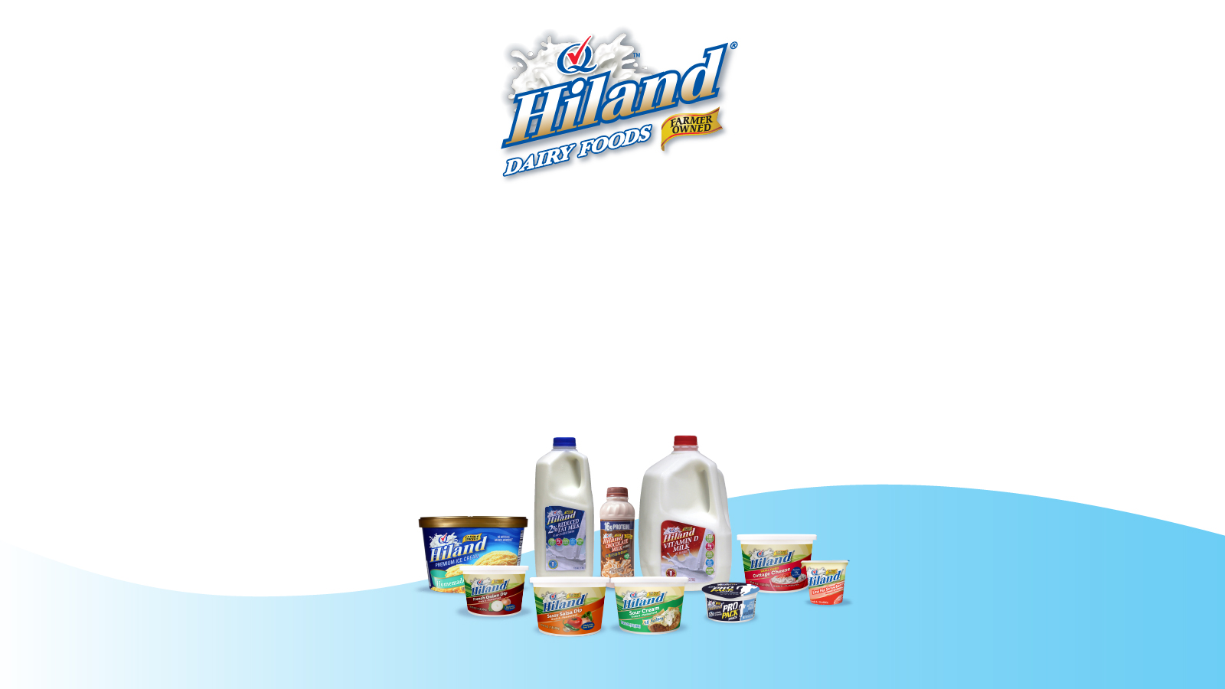
Let’s Build a Stronger
Dairy Partnership!
Connect with your Hiland Dairy Sales Representative today.
Learn how Hiland Dairy can enhance your business with fresh, innovative products.
Visit HilandDairy.com for more information.

Slide 13
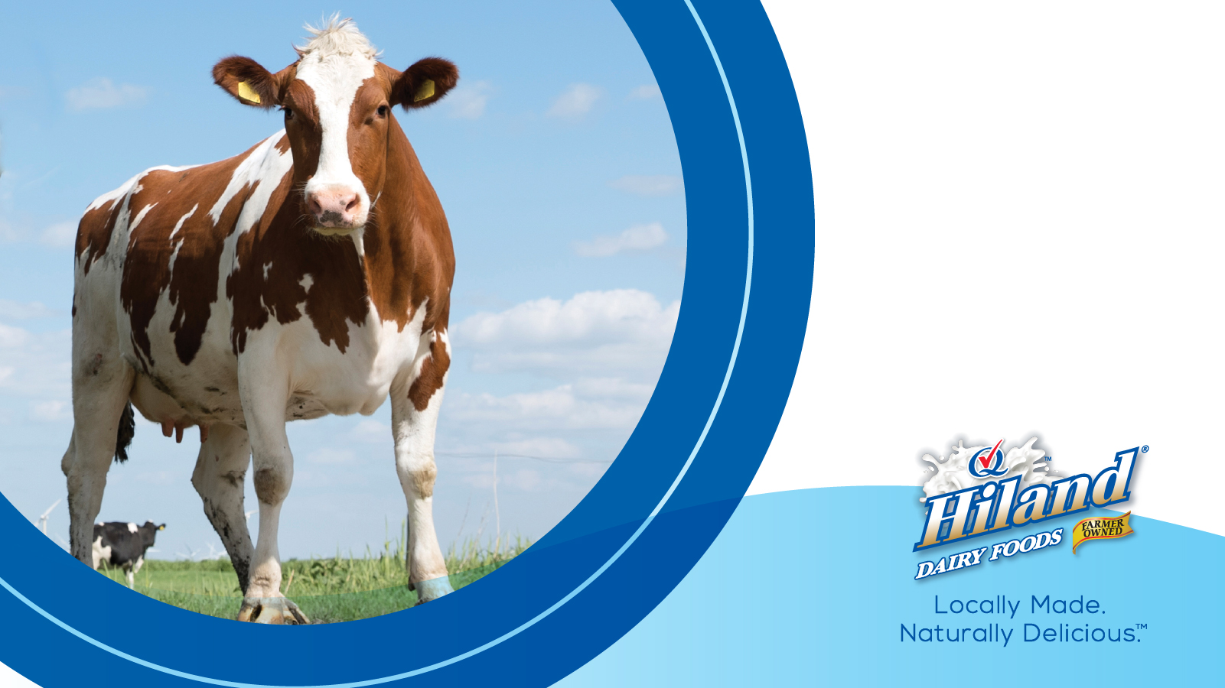

Slide 14
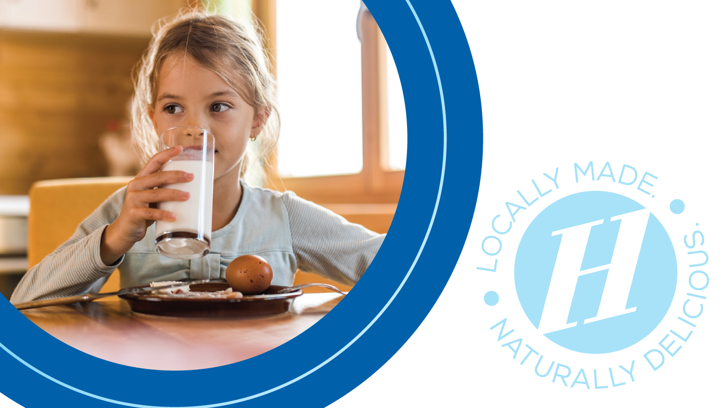

Slide 15
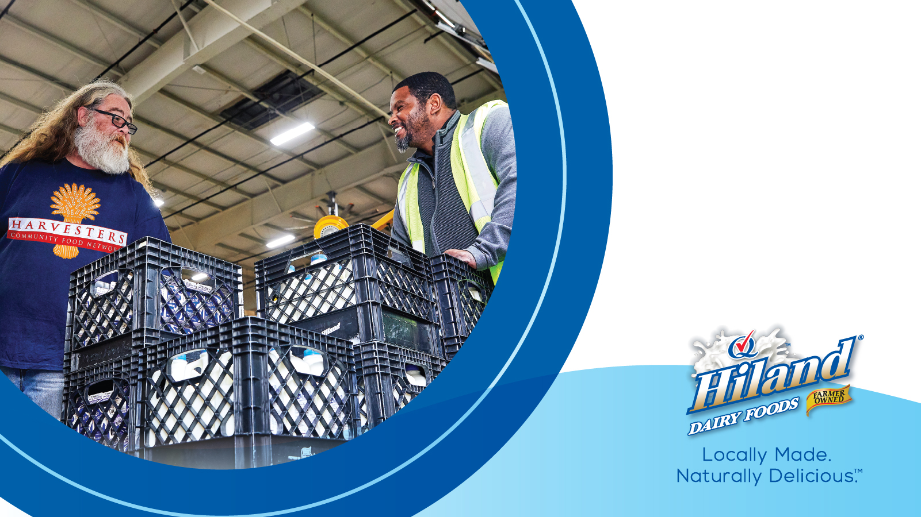

Slide 19
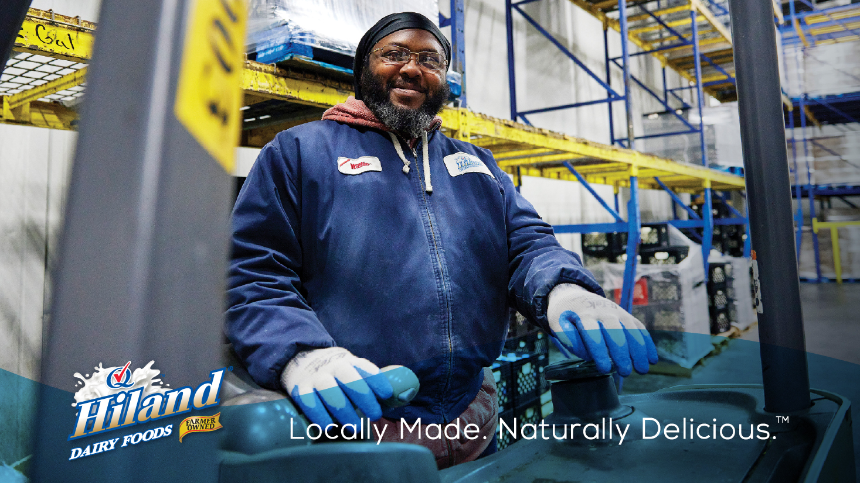

Slide 20


Slide 21


Slide 22
